Slide 1
IBA UPDATE
May 2019

Slide 2
AGENDA
Welcome
Market Update
Independent Seal roll out
Good Beer Week merger
Member Resources
Connecting with members
Brewcon and Indies

Slide 3
MARKET UPDATE

Slide 4
TOTAL BEER CONTINUES TO DECLINE
- 1.5%
“Total Australian Beer Market – 1.619 billion litres”
IRI Data – MAT March 2019

Slide 5
INDEPENDENT BEER – THE SHINING LIGHT
+ 25%
93 Mlts
Total Independent Beer
IBA Read using ATO Data – June 2018

Slide 6
INDEPENDENT BEER – THE SHINING LIGHT
5.9%
Share of Volume
Back in 2011 when CBIA / IBA was established Independent Brewers had just over 1%
IBA Read using ATO Data – June 2018

Slide 7
INDEPENDENT BEER – THE SHINING LIGHT
10%
Share of Value
"Australians spend one in every ten of their beer dollars on Indie Beer”.
IBA Read using ATO Data – June 2018

Slide 8
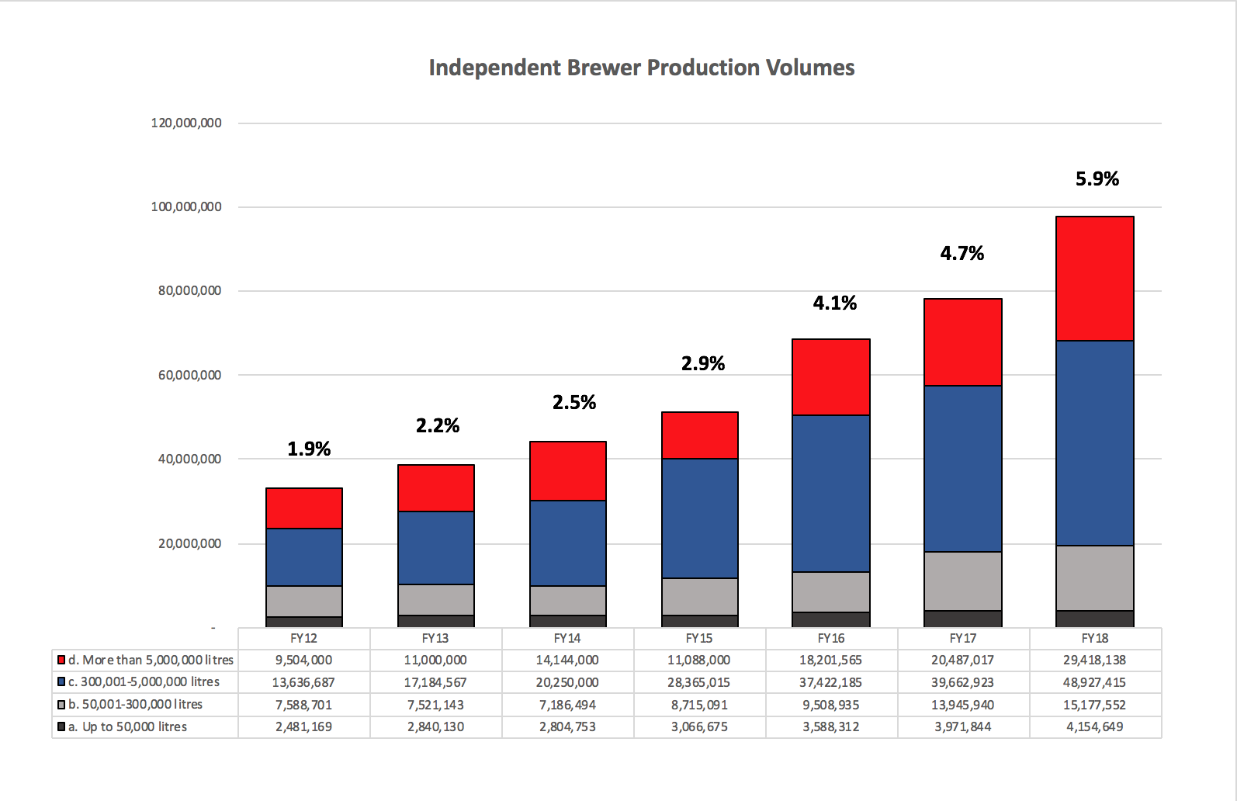
CONTINUED GROWTH
IBA Read using ATO Data – June 2018

Slide 9
BREWER NUMBERS
619
Brewing “companies”
Craft Beer Reviewer – early 2019
472
Excise paying entities
+ 54 or 12.9% Vs PY
IBA Read using ATO Data – June 2018

Slide 10
INDEPENDENT SEAL ROLL OUT

Slide 11

INDEPENDENT SEAL ADOPTION
64%
IBA Brewer Members
IBA Members
58%
of independent beer volume
IBA Read using ATO Data – June 2018

Slide 12
SEAL ROLL OUT
Packaging change overs and product development
There is now a critical mass in the market
The next step is to roll out the Supporters Seal
Following that later in the year the IBA will focus on
  Building consumer awareness
  Building familiarity and understanding
  Creating value in the Seal

Slide 13

SUPPORTER SEAL
Launching in June
Open to trade, industry / suppliers
Supporters will sign up to a sub-licence
IBA to provide support materials

Slide 14
GOOD BEER WEEK MERGER
All set to complete the merger post Good Beer Week
Synergies and opportunities
Events expertise
Industry knowledge
Shared partners – sponsors and affiliates
Opportunity to expand event reach

Slide 15
MEMBER RESOURCES
Adding to the existing member resources
IBA Safe
Labelling Guidelines
Rolling out a Product Recall Guide
A number of Quality “How to” Guides coming soon
IBA Mash Up podcasts / webinars

Slide 16
CONNECTING WITH MEMBERS
Stepping up our connection with members in your market
IBA Mash Ups
Regular opportunities to
  Networking with the industry members
  Information sharing and learning
  Chance to lift the head up and just have a beer together

Slide 17
BREWCON and INDIES
Taken on a lot of feedback from 2018
We’ve listened and adjusted our plans accordingly
Venue is the MCEC - Melbourne
Trade Expo exhibitors locked in
Program in development – Seminar EOI’s coming in
Indies judges selected

Slide 18
NEW INDUSTRY AWARDS FOR THE INDIES
In addition to the existing INDUSTRY SERVICE AWARD
YOUNG GUN OF THE YEAR
COMMUNITY INITIATIVE OF THE YEAR
TRUE INDIE BEER SUPPORTER OF THE YEAR

Slide 19
BREWCON and INDIES – KEY DATES
Indies entries open – 24th May 2019
Brewcon tickets go on sale – 7th June 2019
Indies entries close – 30th June 2019
Indies judging –1st – 2nd September 2019
Brewcon and Trade Show commences – 4th September 2019
Indies Awards night – 5th September 2019

Slide 20
CHEERS !

